Slide 1



Protecting App Secrets with .NET Core & Azure
Scott Addie
@Scott_Addie
Senior Content Developer

Slide 2














































Titanium Sponsors
Platinum Sponsors
Gold Sponsors

Slide 3
Agenda
Identify the problem
Solutions
Secret Manager
Azure Key Vault
Comparison of solutions
Demos

Slide 4

> git add .
> git commit –m “Add connection string to appsettings.json”
> git push origin master
> asdfkasdfkjlasdflkhadfgjfg
appsettings.json
{ "ConnectionStrings": { "Movies": "Server=(localdb)\\mssqllocaldb;Database=Movie-1;User Id=johndoe;Password=pass123;MultipleActiveResultSets=true" } }
Notes:
“Meet John: an overworked, 10x developer fueled by caffeine and pizza.”

Slide 5

The next morning…
Ugh, this is bad!
It appears so…
Did John push his credentials to the repo last night?

Slide 6
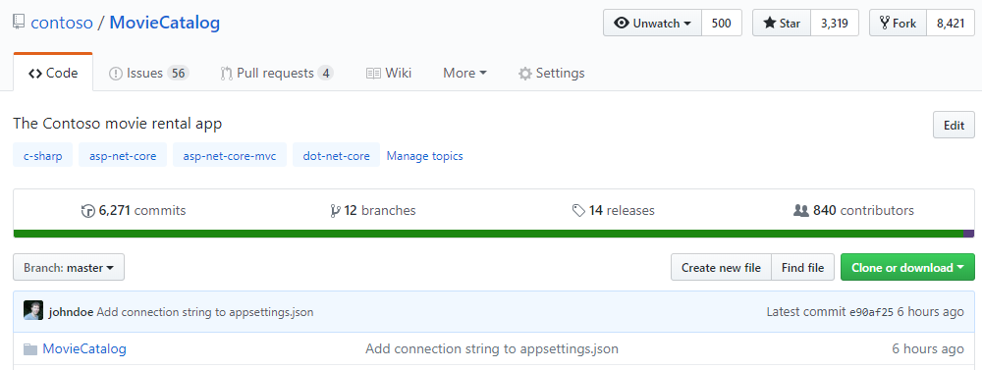
A ticking time bomb in a public repo…

Slide 7
Problem statements
Developer:
“I want my ASP.NET Core app’s sensitive configuration data to be protected, without having to write the code myself.”
CISO:
“I want to know that our apps comply with FIPS 140-2 Level 2 HSMs for secure key management.”
Notes:
FIPS = Federal Information Processing Standard
1 solution to this problem is Secret Manager

Slide 8
Secret Manager
CLI
IDE
Prerequisites
.NET Core SDK v2.1+
Usage
> dotnet user-secrets
Prerequisites
.NET Core SDK v2.1+
VS 2017 15.7+
.NET Core cross-platform development
ASP.NET and web development
Usage
Solution Explorer > right-click project > Manage User Secrets
Notes:
VS SUPPORT
.NET Core support ONLY in 15.7 (secrets.json)
.NET Framework support in 15.8 (secrets.xml)
.NET Core SDK 2.1.300 bundles user-secrets command

Slide 9
Secret Manager: .NET Core CLI
> dotnet user-secrets init
MovieCatalog.csproj
<Project Sdk="Microsoft.NET.Sdk.Web"> <PropertyGroup> <TargetFramework>netcoreapp3.0</TargetFramework> <UserSecretsId>0087f3aa-237b-4c08-a9dc-5927be11eadd</UserSecretsId> </PropertyGroup>
Notes:
init command ONLY in SDK 3.0+

Slide 10



Secret Manager: .NET Core CLI (cont.)
> dotnet user-secrets set “Movies:Password” “pass123” &&
dotnet user-secrets set “Movies:User” “johndoe”
MovieCatalog.csproj
<Project Sdk="Microsoft.NET.Sdk.Web"> <PropertyGroup> <TargetFramework>netcoreapp3.0</TargetFramework> <UserSecretsId>0087f3aa-237b-4c08-a9dc-5927be11eadd</UserSecretsId> </PropertyGroup>
secrets.json
~/.microsoft/usersecrets/<id>/
{ "Movies:Password": "pass123", "Movies:User": "johndoe" }
%APPDATA%\Microsoft\UserSecrets\<id>\

Slide 11
Secret Manager: Retrieval
Startup.cs
public class Startup { private string _connection = null; public Startup(IConfiguration configuration) => Configuration = configuration; public IConfiguration Configuration { get; } public void ConfigureServices(IServiceCollection services) { var builder = new SqlConnectionStringBuilder( Configuration.GetConnectionString("Movies")); builder.UserID = Configuration["Movies:User"]; builder.Password = Configuration["Movies:Password"]; _connection = builder.ConnectionString;

Slide 12

Demo
Secret Manager
Notes:
1. secrets.json: “Event”: { “Name”: “KCDC – secrets.json” }
2. Index.cshtml.cs:
private readonly IConfiguration _config;
public IndexModel(IConfiguration config) =>
_config = config;
public string EventName { get; set; }
public void OnGet() =>
EventName = _config["Event:Name"];
3. Index.cshtml: @Model.EventName

Slide 13
Azure Key Vault
CLI
IDE
Prerequisites
Azure subscription
Azure CLI
Usage
> az keyvault
Prerequisites
Azure subscription
.NET Core SDK v2.1+
VS 2017 15.7+
.NET Core cross-platform development
ASP.NET and web development
Usage
Solution Explorer > double-click Connected Services > Secure Secrets with Azure Key Vault
Notes:
- Azure Cloud Shell ← the best CLI is the one you don’t have to install
- VS 15.7 introduces Connected Services node Key Vault creation
- Key Vault takes precedence over Secret Manager at runtime, since it’s more secure

Slide 14
Key Vault: Azure CLI
az keyvault create --name `MoviesVault` \
--resource-group `MoviesRG` \
--location eastus
az keyvault secret set --vault-name `MoviesVault` \
--name `Password` \
--value `pass123`
az keyvault secret set --vault-name `MoviesVault` \
--name `User` \
--value `johndoe`

Slide 15
Key Vault: Retrieval
ASP.NET Core app:
Index.cshtml
@page @model IndexModel @inject Microsoft.Extensions.Configuration.IConfiguration config <strong>Username:</strong> @config["User"] <strong>Password:</strong> @config["Password"]

Slide 16
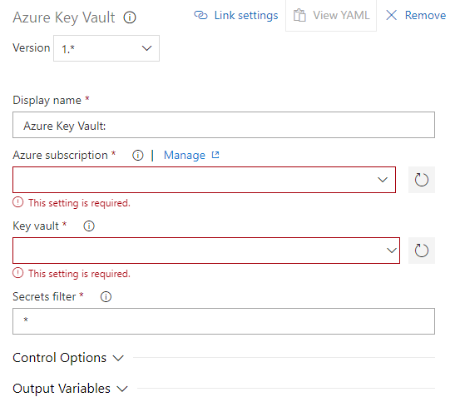

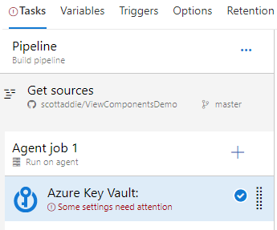
Key Vault: Retrieval (cont.)
Azure Pipelines build:
Azure Key Vault task
Notes:
Download secrets from key vault with build task
Can use secrets as task variables in other build tasks

Slide 17
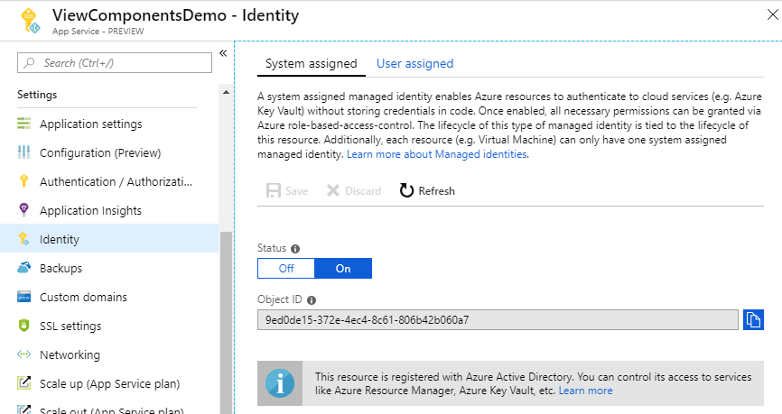
Key Vault: Configure access via portal
Notes:
Managed Service Identity
Allow your app service to communicate w/ other Azure services

Slide 18
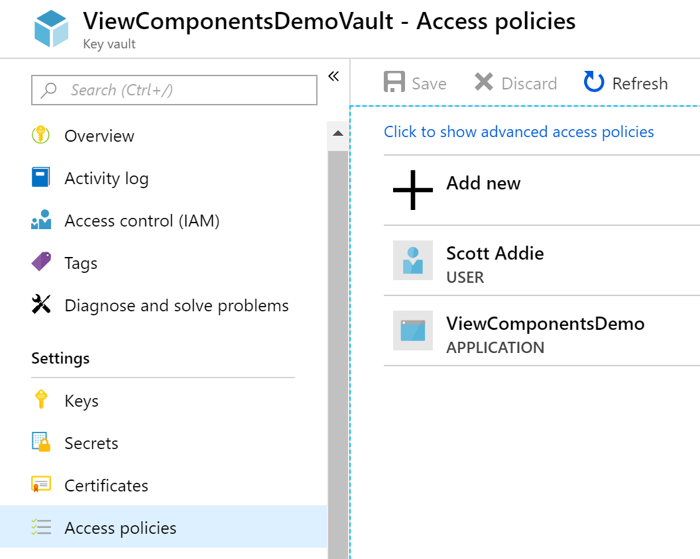
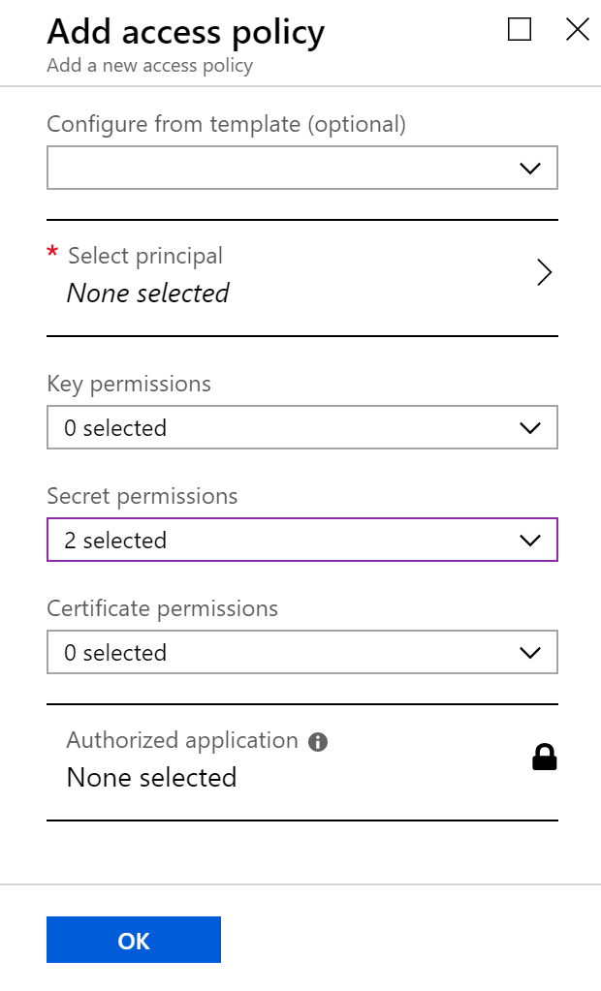
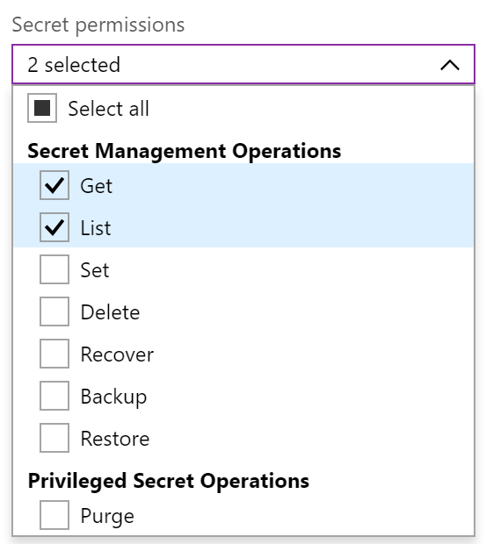
Key Vault: Configure access via portal (cont.)
Notes:
Add yourself for local development support

Slide 19
Key Vault: Configure access via CLI
# Enable Managed Service Identity on web app
az webapp identity assign --name $webAppName
webAppPrincipalId=$(az webapp identity show \
--name $webAppName \
--query principalId \
--output tsv)
az keyvault set-policy --name `MoviesVault` \
--object-id $webAppPrincipalId \
--secret-permissions get list
Notes:
--object-id = GUID that identifies the principal that will receive permissions

Slide 20
Comparison of solutions
 | Secret Manager | Azure Key Vault
Environments | Dev | Dev, Prod
Pricing | Free | $0.03 / 10k operations
Encryption | No | Yes
Storage | Local machine | Azure Storage
Scope | User profile | App
Notes:
Key Vault – secrets stored as sequences of octets (8-bit bytes) w/ max. size of 25 kbs

Slide 21

Demo
Secret Manager + Azure Key Vault
Notes:
show Program.ConfigureKeyVault in ViewComponentsDemo

Slide 22



Resources
Docs @Scott_Addie
aka.ms/dotnet-secret-mgr
aka.ms/az-key-vault
Slides
aka.ms/app-secrets-slides
Code
aka.ms/app-secrets-code

